Slide 1



Vehicle Use At Rowan University
The average fuel economy at Rowan is about 29.7 MPG
On average, Rowan drivers travel 29.3 miles per week
About 4 gallons of gasoline are burned per person at Rowan per week

Slide 2
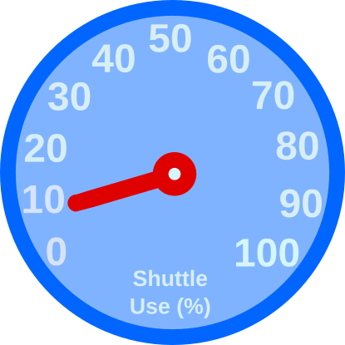

Shuttle Use At Rowan University
The average fuel economy of shuttles at Rowan is about XX.X MPG
Only about 10% of people at Rowan ever use the shuttle services.

Slide 3


Food Waste at Rowan University
Students at Rowan produce roughly XXX pounds of food waste per day.
This much waste could produce XX gallons of biofuel.

